Slide 1
My Precious Bitcoins
Comp 305 Term Project - Group 4

Slide 2
Problem Definition
Find maximum number of (x,y,z) triplets
x, y and z are non-negative integers
x, y and z satisfy x+y+z=n
input is n, (1 ≤ n ≤ 300)
Solve in reasonable time

Slide 3
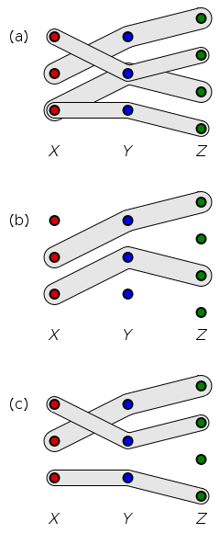
Part I: Graph Theory Perspective
The problem structure is analogous to the several well-known Graph Theory Problems:
3-Dimensional Matching
The Vertex-Disjoint Triangles Problem
Triangle Packing on Tripartite Graphs
Independent Triangle Cover of a Graph
Matchings in Hypergraphs
and so on…
However they are mostly have performance problems due to their already proven NP-Hard nature.
3-Dimensional Matching Problem

Slide 4
Part I: Approximation Algorithms & Heuristics
To obtain far efficient algorithms, either concrete assumptions were made...
O*(1.0836^{n})-time algorithm for maximum independent set in degree-3 graphs
O(n³) algorithm for cographs, O(m√n) algorithm for split graphs (VDT Problem)
...or randomized approximation strategies studied and applied:
Randomized Approximation for Maximum Triangle Packing ((86/169 - 𝛆) -approximation)
Approximating Discrete Collections via Local Improvements

Slide 5
Baseline & Iterations
Two Pointer Technique:
https://github.com/lanxaustralis/my-precious-bitcoins/blob/main/DP%20-%20baseline.ipynb

Slide 6
Part II: Geometric Applications

Slide 7
Part II: Academic Work
N Queen Problem:
https://github.com/mattdixon97/nqueens
https://fizyka.umk.pl/~milosz/AlgIILab/10.1.1.57.4685.pdf

Slide 8
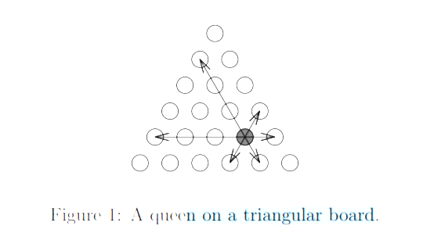
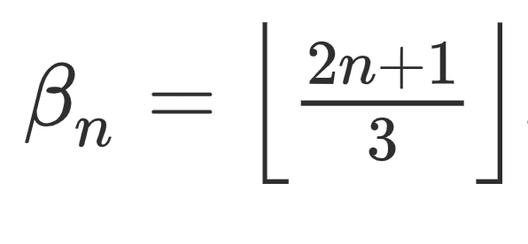
Part II: Academic Work on Geometric Structure
Non-attacking queens on a triangle: https://www.cin.ufpe.br/~pcp/nonattacking_queens.pdf
A survey of known results and research areas for N-Queens: https://www.sciencedirect.com/science/article/pii/S0012365X07010394

Slide 9
Complexity Analysis, Correctness, Future Improvement
Time Complexity: O(n)
Space Complexity: O(n)
Achieves the upper bound for 1 ≤ n ≤ 300
Tested up to n = 300,000
DP can be added to earlier versions

Slide 10
Runtime Results
10 -> 0.000009 seconds -> (3, 0, 7), (4, 1, 5), (5, 2, 3), (6, 3, 1), (0, 4, 6), (1, 5, 4), (2, 6, 2), (3, 7, 0)
50 -> 0.000013 seconds -> (16, 0, 34), (17, 1, 32), (18, 2, 30), (19, 3, 28), (20, 4, 26), (21, 5, 24), (22, 6, 22), (23, 7, 20), (24, 8, 18), (25, 9, 16), (26, 10, 14), (27, 11, 12), (28, 12, 10), (29, 13, 8), (30, 14, 6), (31, 15, 4), (32, 16, 2), (33, 17, 0), (0, 19, 31), (1, 20, 29), (2, 21, 27), (3, 22, 25), (4, 23, 23), (5, 24, 21), (6, 25, 19), (7, 26, 17), (8, 27, 15), (9, 28, 13), (10, 29, 11), (11, 30, 9), (12, 31, 7), (13, 32, 5), (14, 33, 3), (15, 34, 1)
100 -> 0.000015 seconds -> (33, 0, 67), (34, 1, 65), (35, 2, 63), (36, 3, 61), (37, 4, 59), (38, 5, 57), (39, 6, 55), (40, 7, 53), (41, 8, 51), (42, 9, 49), (43, 10, 47), (44, 11, 45), (45, 12, 43), (46, 13, 41), (47, 14, 39), (48, 15, 37), (49, 16, 35), (50, 17, 33), (51, 18, 31), (52, 19, 29), (53, 20, 27), (54, 21, 25), (55, 22, 23), ..., (28, 62, 10), (29, 63, 8), (30, 64, 6), (31, 65, 4), (32, 66, 2), (33, 67, 0)
150 -> 0.000018 seconds -> (50, 0, 100), (51, 1, 98), (52, 2, 96), (53, 3, 94), (54, 4, 92), (55, 5, 90), (56, 6, 88), (57, 7, 86), (58, 8, 84), (59, 9, 82), (60, 10, 80), (61, 11, 78), (62, 12, 76), ..., (41, 92, 17), (42, 93, 15), (43, 94, 13), (44, 95, 11), (45, 96, 9), (46, 97, 7), (47, 98, 5), (48, 99, 3), (49, 100, 1)
200 -> 0.000020 seconds -> (66, 0, 134), (67, 1, 132), (68, 2, 130), (69, 3, 128), (70, 4, 126), (71, 5, 124), (72, 6, 122), (73, 7, 120), (74, 8, 118), (75, 9, 116), (76, 10, 114), (77, 11, 112), (78, 12, 110), (79, 13, 108), (80, 14, 106), (81, 15, 104), (82, 16, 102), (83, 17, 100), (84, 18, 98), (85, 19, 96), (86, 20, 94), (87, 21, 92), (88, 22, 90), (89, 23, 88), (90, 24, 86), (91, 25, 84), (92, 26, 82), (93, 27, 80), (94, 28, 78), (95, 29, 76), (96, 30, 74), (97, 31, 72), (98, 32, 70), (99, 33, 68), ..., (42, 111, 47), (43, 112, 45), (44, 113, 43), (45, 114, 41), (46, 115, 39), (47, 116, 37), (48, 117, 35), (49, 118, 33), (50, 119, 31), (51, 120, 29), (52, 121, 27), (53, 122, 25), (54, 123, 23), (55, 124, 21), (56, 125, 19), (57, 126, 17), (58, 127, 15), (59, 128, 13), (60, 129, 11), (61, 130, 9), (62, 131, 7), (63, 132, 5), (64, 133, 3), (65, 134, 1)
250 -> 0.000023 seconds -> (83, 0, 167), (84, 1, 165), (85, 2, 163), (86, 3, 161), (87, 4, 159), (88, 5, 157), (89, 6, 155), (90, 7, 153), (91, 8, 151), (92, 9, 149), (93, 10, 147), (94, 11, 145), (95, 12, 143), (96, 13, 141), (97, 14, 139), (98, 15, 137), (99, 16, 135), (100, 17, 133), ..., (81, 165, 4), (82, 166, 2), (83, 167, 0)
300 -> 0.000029 seconds -> (100, 0, 200), (101, 1, 198), (102, 2, 196), (103, 3, 194), (104, 4, 192), (105, 5, 190), (106, 6, 188), (107, 7, 186), (108, 8, 184), (109, 9, 182), (110, 10, 180), (111, 11, 178), (112, 12, 176), (113, 13, 174), (114, 14, 172), (115, 15, 170), … (83, 184, 33), (84, 185, 31), (85, 186, 29), (86, 187, 27), (87, 188, 25), (88, 189, 23), (89, 190, 21), (90, 191, 19), (91, 192, 17), (92, 193, 15), (93, 194, 13), (94, 195, 11), (95, 196, 9), (96, 197, 7), (97, 198, 5), (98, 199, 3), (99, 200, 1)

Slide 11
Thank You!
Comp 305 Term Project - Group 4

